Slide 1
Outlook Safety Checks
John C. Checco
Rev 1.3.*
2022-01-12

Slide 2
Basic Element Verifications
Host/Domain/IP
Email Addresses
IDN/PUNYcode/Diacratic masquerading
WHOIS lookup
DNS Blacklist
Breach History (HaveIBeenPwned)
Local Rules (Host/Domain/TLD)
Per-User Whitelist
Per-User Blacklist
IDN/ Diacratic masquerading (User)
Name (if “@”) == Address
← Email Host/Domain Checks
Leakage/PasteBin History (HIBP)
Local Rules
Whitelist against Contact Lists
Flag Unknown Addresses
To Do:
Dig/Finger verification

Slide 3
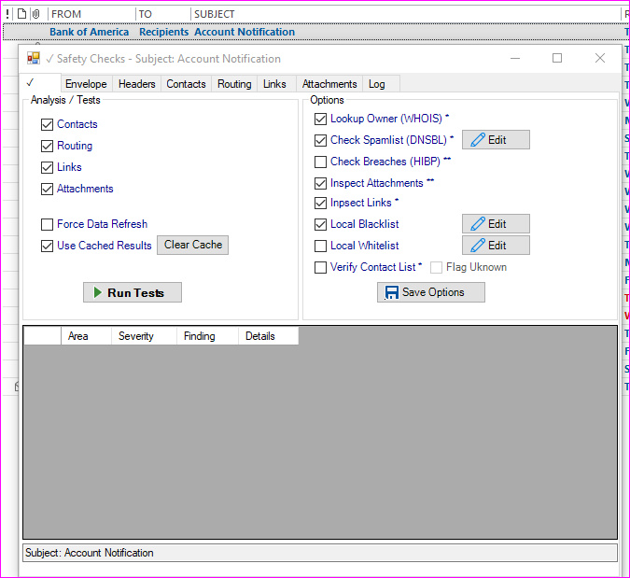
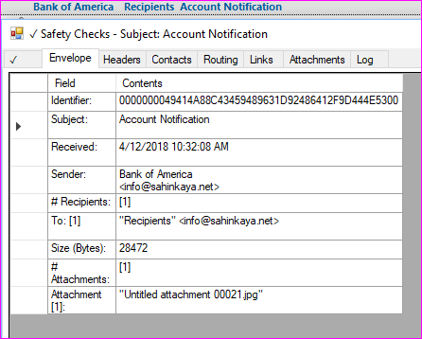

Slide 4
Header Checks
Header Parsing
To Do:
Spoofed Tag Verification
AV/Spam
SPF/DKIM
Non-Standard Tags
Non-Standard Values
SPF/DKIM Validation

Slide 5
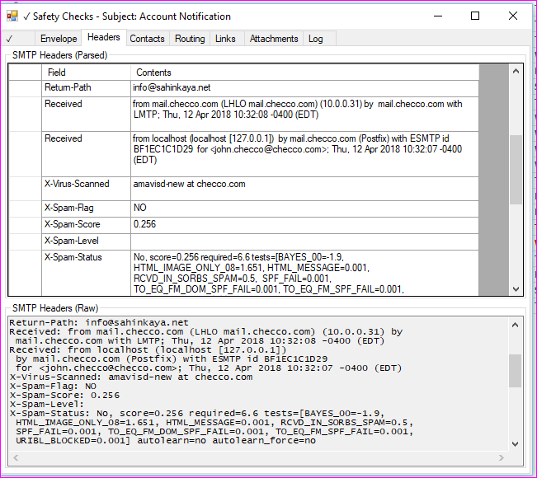

Slide 6
Contact Checks
Email Address Checks
From: == Reply-To: == Return-Path:
Abnormal Number of Recipients
No explicit recipients (all BCC)
Too many recipients (>25)
To Do:
AI logic to determine Confidence of Email alignment to Display Name

Slide 7
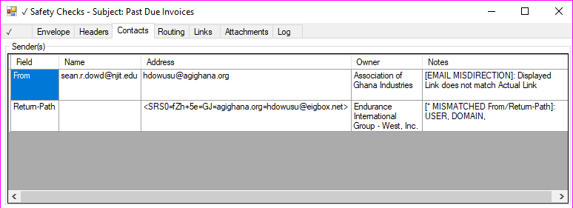
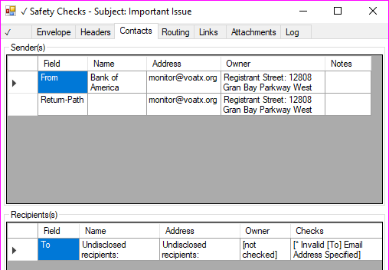

Slide 8
Routing Checks
Route Parsing
Route Host/Domain Checks
Route IP Checks
Verify Host→IP mapping (From/By parts)
To Do:
AI logic to determine confidence of normal routing path

Slide 9
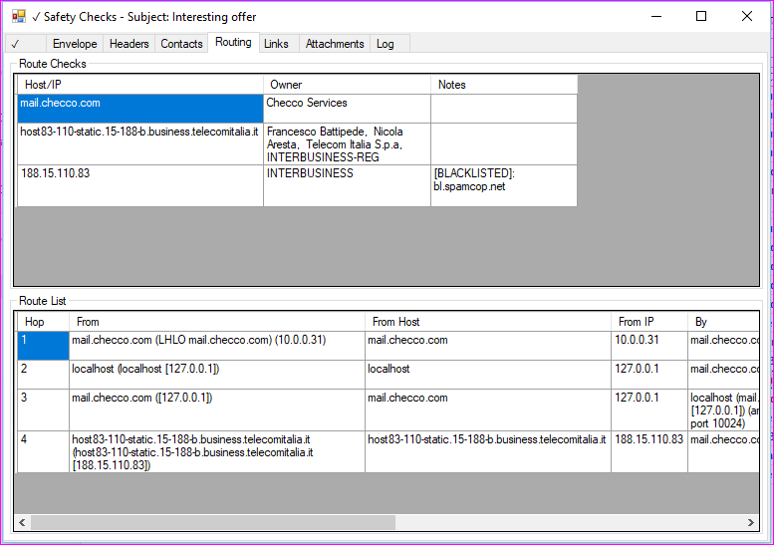

Slide 10
Link Checks
Link File Type (HEAD → Content-Type:)
Link Type Blacklist (executables, etc)
Misdirection
Display Name (containing “xxx:”) == Actual Link
Email Checks (mailto:)
URLs using explicit IP addresses
URLs referencing local filesystem
To Do:
Nested URLs
TinyURL expansion → Link Checks
A/V Scanning

Slide 11
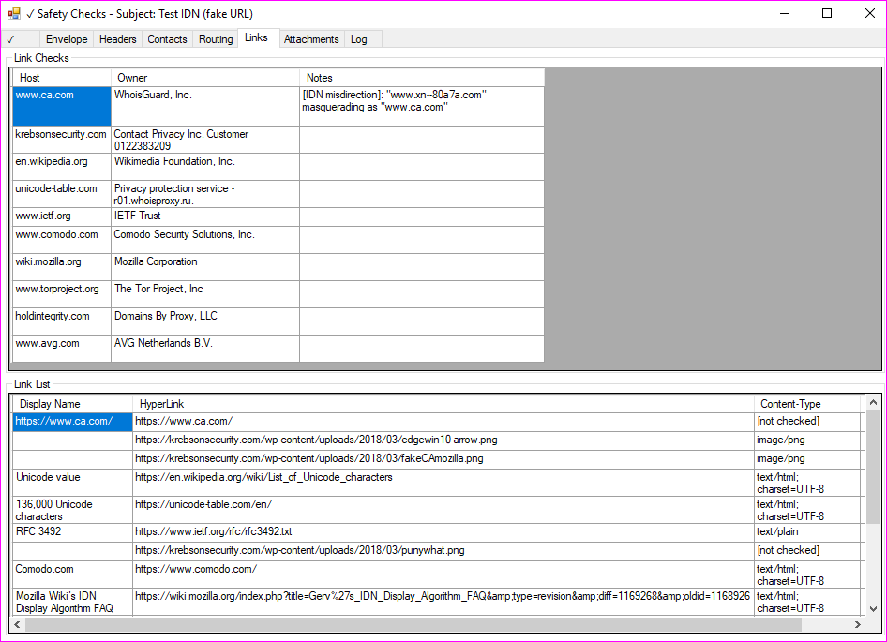

Slide 12
Attachment Checks
File Extension == Binary Signature
File Type Blacklist (executables, etc)
MIME Multipart Content-Type == Binary signature
To Do:
A/V Scanning
Deep Inspection
Nested Emails
Nested Zips

Slide 13
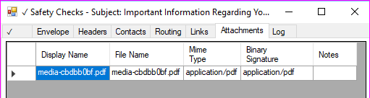
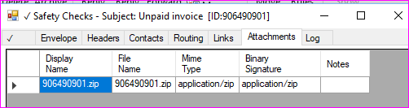

Slide 14
Image Checks
Beaconing (0px)
Links with Query Parameters
To Do
Remote Images → Link Checks
Local Images → Attachment Checks

Slide 15
Content Checks
Parsing for Links/Images
HTML (Easy)
RTF (Medium Difficulty)
Plain Text (Maximum Difficulty)
Parsing for Hidden Data/Text in HTML/CSS
Invisible Font
0-sized elements
Fragmented Data (intertwined with RTF/HTML comments)
External object identification/inspection
<IFRAME>, <OBJECT>, <EMBED>, <APPLET>, <IMG>, <A>
Non-standard content:
IDN, PUNYcode, Diacratic and non-ASCII charsets
L33Tspeak (best guess)
Codepages whitelist
Country Language whitelist
To Do
Parsing Multipart Messages (non-Attachments)
Javascript → XSS/CSRF identification/warning

